Slide 1
Cuyamaca Learning Assistance
We Make Good Students Better

Slide 2


For Instructors
Who we are
What we do
How we do it
The proof
How you can help
You can’t over communicate about LA with students.
Please beware of stigma
PLEASE look for great potential tutors among your own students and share their contact info with us
Mary is happy to meet to try to tailor services to meet the needs of your students

Slide 3
Tutoring/Learning Assistance Fills the Gaps
STUDENT
TEACHER
TUTOR

Slide 4
Helpful Faces and Names
Faculty Tutoring Coordinator – Mary Graham
Full-time Staff
Academic Resource Center (ARC) -- Veronica Nieves, M Ed.
STEM Center – Corrine Hensley, MA Anthropology (In-Process)
Writing Center – Taylor Fiehler, BA Communication
Part-time Staff
Samantha Lee, MSW
Maria Mendoza-Bautista, PhD Leadership and Change (In-Process)

Slide 5
The Other Team Members You Will Meet
Trained Peer Tutors (Blue vests): Current and Former CC students
Front Desk Staff (some have red vests): Work-study or CalWORKS financial aid. Learning job skills.

Slide 6
Our Responsibilities are to . . .
Meet
meet each learner exactly where he or she is at academically and in terms of student and study skills and habits.
Promote
promote development of learner confidence and independence
Support
support all students in every course in acquiring course skills and knowledge as well as student skills and knowledge.
Improve
Improve student success.

Slide 7
PLOs
PLO 1. Promote tutee empowerment, independence, and long-term success through culturally conscious, learner-centered, process-oriented tutoring which promotes self-regulated learning.
PLO 2. Positively impact student success, retention, persistence, improvement, and completion – with special focus on issues of disproportionate impact.
PLO 3: Support instructors and programs by providing individualized academic support that meets the specific needs of our diverse body of students.
PLO 4. Promote pursuit of education and educational career goals among our diverse pool of Cuyamaca Student and Cuyamaca Alumni tutors.

Slide 8
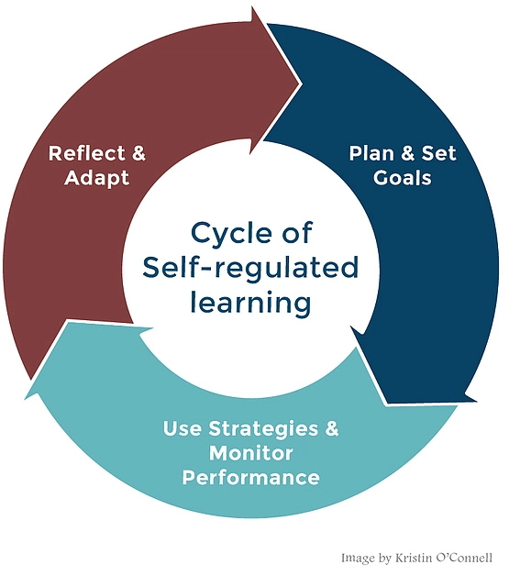
Promoting Self-Regulated Learning
What independent learners do

Slide 9
How do students learn to be self-regulated? Through Metacognitive Conversations

Slide 10
The Tutoring Session Cycle as Metacognitive Conversation
Greeting
Agenda Setting
Metacognitive Moment
Next steps
Tutoring

Slide 11
Tutorial Record Slip Copies Go To . . .
Student
Instructor
Center --for Data Collection and Analysis

Slide 12
Tutoring Services Offered
One-on-one 30 minute appointments – 25/5 Tutoring/Data
1-2 Hour Group Tutoring –5 to 10 minutes for data collection
Online tutoring Local and Net Tutor
Embedded tutoring
Hosted tutoring – DSPS High Tech Lab, VRC, Counseling Classes
Lab Tutoring

Slide 13
ARC: Tutoring in all subjects that are NOT Math, Science, Engineering or Writing
619-660-4306
veronica.nieves@gcccd.edu
EVENING TUTORING: 6-8 Pm on T and W held in the Writing Center, B 167
MTWTH 9-6, F 9-12
C-102 (Library building)

Slide 14
STEM Center: Science, Math, Engineering Tutoring
619-660-4396
H Building First Floor
MTWTH 9-6, F 9-2
EVENING TUTORING: 6-8 Pm on T and W held in the Writing Center, B 167
corrine.hensley@gcccd.edu

Slide 15
Writing Center: Supporting writing for all campus courses
619-660-4463
B-167
MTh 9-6, TW 9-8, F 9-3
taylor.fiehler@gcccd.edu

Slide 16
Our Website and Access to Net Tutor 24/7 Online Tutoring Service
https://www.cuyamaca.edu/academics/support/tutoring/default.aspx

Slide 17
ARC users were more likely to complete courses AND succeed in them than non-users
Subject | % More likely to Complete | % More likely to Succeed
Child Dev | 16% | 23%
All CTE (2013-14) | 10% | 13%
All underserved student groups had higher success and retention if they used ARC

Slide 18
STEM users were more likely to complete courses AND succeed in them than non-users
Subject | % More likely to Complete | % More likely to Succeed
Bio | 9% | 21%
Chemistry | 14% | 17%
Transfer Level Math | 8% | 13%

Slide 19
Writing Center
Under the long ESL pathways, ESL students who used the Writing Center were twice as likely to make it to, and successfully complete transfer level English, than non-users.
English students who visited the Writing Center 7 times were 12 percent less likely to drop and 25 percent more likely to pass than students who did not visit.
Humanities students who visited the Writing Center but not ARC were 20 percent more likely to pass the course than students who did not visit the Writing Center or ARC.

Slide 20
What can you do?
Beware of stigma
Advocate tutoring early and often
Make it a requirement for all students
Know what we do and prepare students for it
Attend an orientation or have an in-classroom orientation if one is offered
Let students know about Gear Up for finals December 5, 6, 10, 11 when all centers run 9-8.
Respond to our emails – we serve students best when we communicate
PLEASE, PLEASE, PLEASE RECOMMEND TUTORS TO US
Share the Learning Assistance PowerPoint we made for students

Slide 21

Please, please, please respond to our emails and recommend tutors directly to us
From: Student CIV FRCSW, 63120
Sent: Tuesday, September 18, 2018 12:25 PM
To: Veronica Nieves <veronica.nieves@gcccd.edu>
Subject: RE: tutoring
Hey veronica any word I think I'm going to drop ___________, the work load for me is too much without any help
Student
Equipment Project Manager
Fleet Readiness Center Southwest
Code 6.3.1, Bldg. 90-2
Desk: 619-545-3053
"You Never Fail Until You Stop Trying" -Albert Einstein

Slide 22

Questions or comments?

Slide 23
Cuyamaca Learning Assistance
We Make Good Students Better

Slide 24

Cuyamaca Students
We are Cucyamca/Tutoring/Learning Assistance
This power point will introduce you to our staff, our three centers, our services, our website, and it will help you make an appointment, prepare for a session, and make the most of your session.

Slide 25

Helpful Names
Faculty Tutoring Coordinator –- mary.graham@gcccd.edu
Full-time Staff
Academic Resource Center (ARC) -- veronica.nieves@gcccd.edu
STEM Center – corrine.hensley@gcccd.edu
Writing Center – Taylor Fiehler taylor.fiehler@gcccd.edu

Slide 26
The Other Team Members You Will Meet
Trained Peer Tutors/Learning Assistants (Blue vests): Current and Former Cuyamaca students, just like you. (Think about becoming a tutor, yourself)
Front Desk Staff (some have red vests): Work-study or CalWORKS financial aid. Learning job skills.

Slide 27
Our Responsibilities are to . . .
Meet
Meet you exactly where you are at in terms of course skills, student skills, knowledge of how college works, and even stress level. ☺
Help
Help you become the confident and independent learner you are ready to be.
Support
Support every student in every course in acquiring course skills and knowledge as well as student skills and knowledge.
Success
Help you make yourself successful in college and life.

Slide 28
ARC: Tutoring in all subjects that are NOT Math, Science, Engineering or Writing
619-660-4306
veronica.nieves@gcccd.edu
EVENING TUTORING: 6-8 Pm on T and W held in the Writing Center, B 167
MTWTH 9-6, F 9-12
C-102 (Library building)

Slide 29
STEM Center: Science, Math, Engineering Tutoring
619-660-4396
H Building First Floor
MTWTH 9-6, F 9-2
EVENING TUTORING: 6-8 Pm on T and W held in the Writing Center, B 167
corrine.hensley@gcccd.edu

Slide 30
Writing Center: Supporting writing for all campus courses
619-660-4463
B- 167
MTh 9-6, TW 9-8, F 9-3
taylor.fiehler@gcccd.edu

Slide 31
Tutoring Services Offered
One-on-one 30 minute appointments – 25/5 Tutoring/Data
1-2 Hour Group Tutoring –5 to 10 minutes for data collection
Online tutoring Local and Net Tutor
Embedded tutoring
Hosted tutoring – DSPS High Tech Lab, VRC, Counseling Classes
Lab Tutoring

Slide 32
Our Website and Access to Net Tutor 24/7 Online Tutoring Service
https://www.cuyamaca.edu/academics/support/tutoring/default.aspx

Slide 33

Making An Appointment
You can call or come by the appropriate center
Bring your Student ID
Know the Subject and Number (Math 160/60)
Four digit section number (5654)
Instructor Name
Please know when you are available to make an appointment
We operate on a first come, first served basis, so make appointments early as the time and; come early and often

Slide 34
Additional Appointment Scheduling Info
All centers: You can make one appointment at a time, with a minimum one hour between appointments for you to continue applying the skills or knowledge you learned
Maximum two appointments per day
Some centers have weekly appointment caps due to funding
Student Use Computer Areas in STEM Center and Writing Center

Slide 35

Canceling an Appointment
If you can’t make it to an appointment, that’s fine. But please call to cancel so we can give your appointment to another student in need.
The ARC needs a minimum of 24 hours of notice.
STEM needs a minimum of 1 hour notice
The Writing Center needs a minimum of 5 minutes notice

Slide 36
What to Expect in an Tutoring/LA Session
Agenda – what specifically would you like to work on today?
Socratic Questioning – the tutor will use questioning to understand exactly where you are at – especially in the one-on-one sessions. Questioning will also help prompt your thinking and help you discover answers on your own.
You will write all corrections so you remember them better and have a written record to go back to review what you have learned
“Teach that back to me” or “Tell me why you did that?”
What do you feel more confident about after completing this session?
Next steps – this leaves you with a plan about how to proceed and helps with stress

Slide 37
Getting the Right Fit
Change
If you don’t like the first tutor you work with, try another. (Different people have different learning styles and personalities)
Pacing
Feel free to ask the tutor to slow down or speed up
Ask
Ask them to explain something again or differently if that is what you need
Speak up
If you realize you need to change the agenda because you see that some point has become more important, speak up
Contact
If you have a complaint or concern or a compliment, please contact one of us on the introductions slide

Slide 38
How to Prepare for an LA Appointment
Bring your textbook, any readings or handouts
Bring your class notes
Bring a printed copy of your assignment sheet
Bring a printed copy of your essay – if you are at that stage of drafting
Course Homework. Make sure you have attempted to do all of the portions that you can..
Test Review. Identify your areas of confusion prior to coming to the appointment.
Come with clear questions, a sense of what you know and what you don’t, and/or an idea about where you are getting lost. Try for something doing in 25 minutes or in a group
If you can’t figure out what you know and where you are lost or what can be done in 25 minutes, come anyway, and explain what you can to the Tutor/Learning Assistant

Slide 39
Tutorial Record Slips Copies Go To . . .
Student
Instructor
Center for Data Collection and Analysis

Slide 40

Come see us soon!

