Slide 1
Technology Ranking
2018 – 2019 requests
Subcommittee: Steve Weinert, Sherri Braaksma, Cyndy Bourget, Jodi Reed, Miriam Simpson, Greg Vega

Slide 2
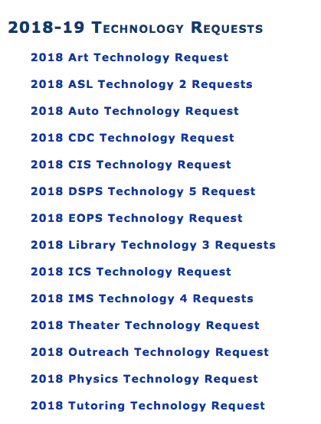
Requests Submitted
Full versions can be found on the Cuyamaca Intranet: https://www.cuyamaca.edu/in/committees/ctc/2017-18-technology-requests.aspx

Slide 3
Rubric Summary
Relationship to Strategic Plan
Mandate or Supports state-wide initiatives
Urgency
Total Cost of Ownership
Data-informed
Resource impact
Funding impact
Evaluation
Link to actual rubric:
https://www.cuyamaca.edu/in/committees/ctc/files/documents/2017/cuyamaca-college-technology-projects-prioritization-rubric.pdf

Slide 4
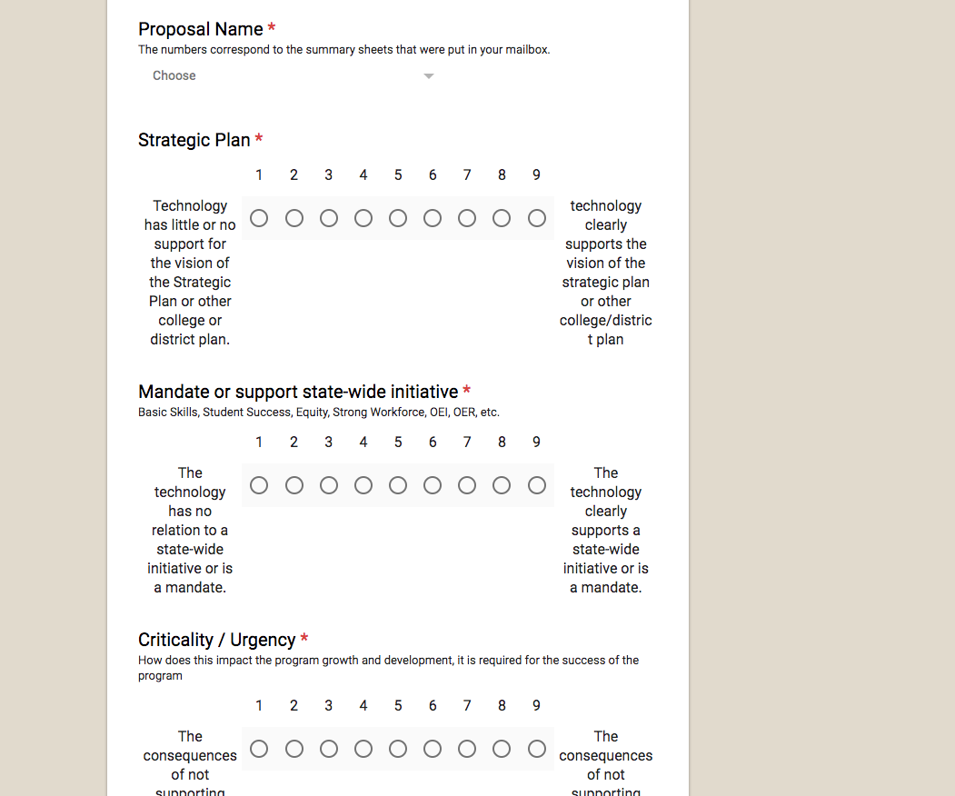
Ranking Procedures
It looks like this...
Subcommittee members read proposals and fill out a form that follows the priorities set by the rubric.
Link to actual form: https://docs.google.com/forms/d/1GFok92GcX462K15ufZbk4qN1gjJcUb46cfncAHK9Hw8/edit

Slide 5
Overall Priority Ranking
The committee felt that, though the process could use some clean up, the results matched our qualitative assessments relatively well
Actual Rankings

Slide 6
Requests by Type
Department | Total Request Cost
ART | $2,666.71
ASL | $14,707.85
AUTO | $3,300.00
CD | $13,331.37
CIS | $151,365.32
DSPS | $77,802.68
IMS | $203,999.00
LRC | $114,369.12
MUSIC | $5,328.00
OUTREACH | $2,928.00
SCIENCE | $2,947.00
TECH MALL | $127,808.54
THEATER | $74,324.00
TUTORING | $4,000.00
Total | $798,877.59

Slide 7
Requests by Impacted User
Department | Total Request Cost
ART | $2,666.71
ASL | $14,707.85
AUTO | $3,300.00
CD | $13,331.37
CIS | $151,365.32
DSPS | $77,802.68
IMS | $203,999.00
LRC | $114,369.12
MUSIC | $5,328.00
OUTREACH | $2,928.00
SCIENCE | $2,947.00
TECH MALL | $127,808.54
THEATER | $74,324.00
TUTORING | $4,000.00
Total | $798,877.59

Slide 8
How are we doing over time?

Slide 9
2017 ------------------- 2018

