Slide 1
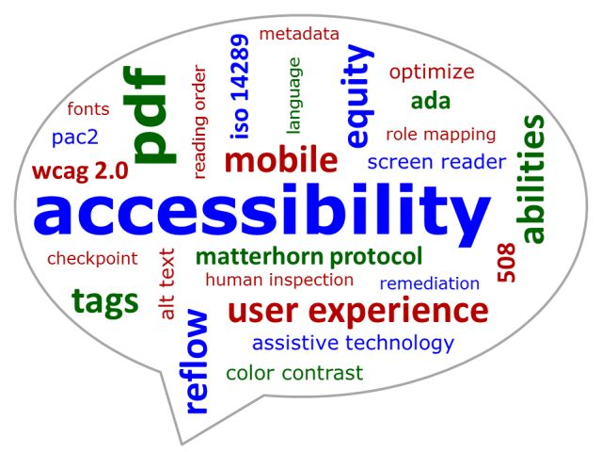
Introduction to Accessibility
Cuyamaca College
Notes:
Hello, and welcome to the Introduction to Accessibility discussion.

Slide 2
General Housekeeping Items
Do not forget to sign the attendance sheet
Do not forget to submit the online attendance form at the end of flex week
Turn in workshop evaluations online
Notes:
General housekeeping items: Do not forget to sign the attendance sheet, Do not forget to submit the online attendance form at the end of flex week, and Turn in workshop evaluations online

Slide 3
Purpose of this Discussion
What you need to know to get started
Where to find support
Be in compliance with laws
Notes:
The purpose of the workshop is to provide information on what an instructor needs to know in order to get started creating accessible courses and materials, and where to find support when you have questions. We will also talk about the importance of complying with state and federal laws.

Slide 4
Accessibility: Access
Root word = Access
Accessible design allows people with disabilities access to electronic communication and information provided to everyone else.
Accessibility involves creating materials that facilitate multiple learning needs and interact with adaptive technologies.
Allows access to people with vision, hearing, cognitive and motor impairments.
Notes:
What is accessibility? The root word is obviously “access”. Accessibility gives access to all individuals, not just those with disabilities. Some examples of disabilities are vision and hearing impairments and cognitive and motor impairments. So, how is accessibility achieved? We use accessible design techniques that allow people with disabilities to have access to electronic communication and information that everyone else uses. Accessibility involves creating not only web pages, but all materials that facilitate multiple learning needs and interact with adaptive technologies.

Slide 5
Population
All Students
  Normal “non disabled”
  ESL
  Aging
  Retraining
  Veterans
  Etc…
Disabled Students
  Visually impaired: blindness, low vision, color-blindness
  Hearing impaired: deafness
  Physically impaired: limited fine or gross motor control, coordination, limited motor function
  Cognitively impaired: learning disabled, distractibility, inability to remember
  WebAIM: http://webaim.org/intro/#video
Notes:
So who is accessibility really for and do we want to create access to courses and materials only for students with disabilities? No! We want to use accessible design to create accessible courses and materials for students with as many learning styles as possible. All students do not learn the same way. Some students are visual learners, some are auditory learners, while others are tactile/hands on learners. We want to create courses and materials that cover as many learning styles as possible. Remember to take into consideration the college’s demographics. Much of our student population is older, coming for training or retraining, veterans, have disabilities, and in many cases English is their second language.

Slide 6
Why?
It is the right thing to do
It is smart
  Increases access for all students
  Provides more options
  Reaches more students
  Increases retention and student success
Allows you to take control of your course
It is the law
Notes:
Why do you, as an instructor, want to create greater access to your course and materials? First and foremost because it is the right thing to do. Second, it is smart. Why is it smart? It allows you to increase access by all students, provide more learning options, reach more students, increase retention and student success. Most importantly, you take control of your course when you create your own materials. Someone else is not doing it for you and second guessing what you want. Finally, it is the law.

Slide 7
Getting Started
Start in the design phase of your course & course materials
As you add and/or update materials
Notes:
At this point in time, you might be wondering how to get started? The best place to start is in the design phase of your course and course materials. It is recommended that as your courses and materials are updated, you update their accessibility.

Slide 8
How
Download or get a hold of an accessibility Checklist
Revise your materials as you update them
Access resources provided to you today
Notes:
We created a checklist that covers all the requirements for accessibility in plain English. We knew this would be too much to take on all at once, so we broke it down into three sections which we’ll provide training for over a three semester period.
This doesn’t mean you have to do everything at once to make every piece of online material accessible. A better way to approach this is to update and revise your material as go. Just do this one week at a time and by the end of the semester, your material will be accessible.
You can attend labs during staff development week that will be staffed by the Online Teaching and Learning Committee who will be able to work with you individually to update your material.
It’s important to know that when your online courses are evaluated, they will be checked for accessibility.

Slide 9
Support and Resources
@One Courses Self Paced Courses
Help Desk (660-4395)
DSPS: http://www.cuyamaca.edu/dsps/
Do-It: 20 Tips for Teaching an Accessible Online Course
Linda.com: Accessibility Training and Tutorials
Training each semester
Notes:
Here are some ways you can get support. We will be providing training and staffed labs during staff development week. Take the online course offered by @One “Creating Accessible Online Courses”. You can call the help desk at 660-4395. The DSPS website has accessibility information at www.cuyamaca.edu/dsps. Another resource that all faculty teaching online should subscribe to is the blog that Rhonda Bauerlein writes that gives critical information that you need to know about teaching online at Cuyamaca College.

Slide 10
Support and Resources (continued)
Chancellors Office: http://www.cccco.edu
Accessibility Checklist: https://www.cuyamaca.edu/services/dsps/files/Accessibility_Checklist.pdf
CCC Accessibility Center: https://cccaccessibility.org/
WCAG 2.1: Web Content Accessibility Guidelines
Accessibility-OEI-Course-Design-Rubric
Notes:
Here are some good resources to learn more about accessibility, distance education guidelines and the law: the California Community College Chancellors Office, the Access Board, US Department of Justice, and the High Tech Center Training Unit.

Slide 11
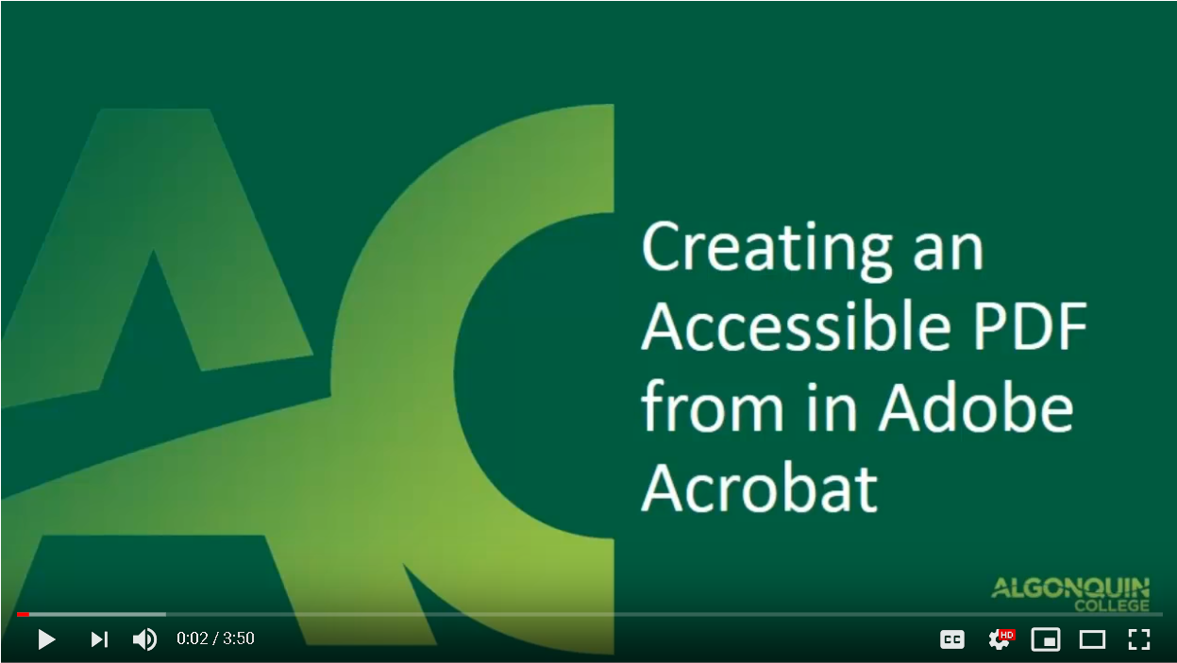
PDF Accessibility

Slide 12
Student Uses and Perceptions of
Closed Captions and Transcripts
by
Katie Linder, Ph.D.
Research Director, Oregon State University Ecampus
Notes:
Recently published research study by Katie Linder, Ph.D., Research Director, Oregon State University Ecampus

Slide 13
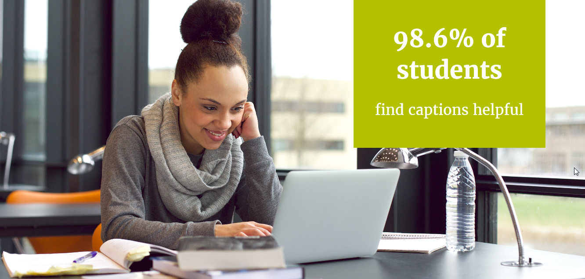
98.6 % of students find captions helpful
Notes:
Ninety eight point six percent of students find captions helpful

Slide 14
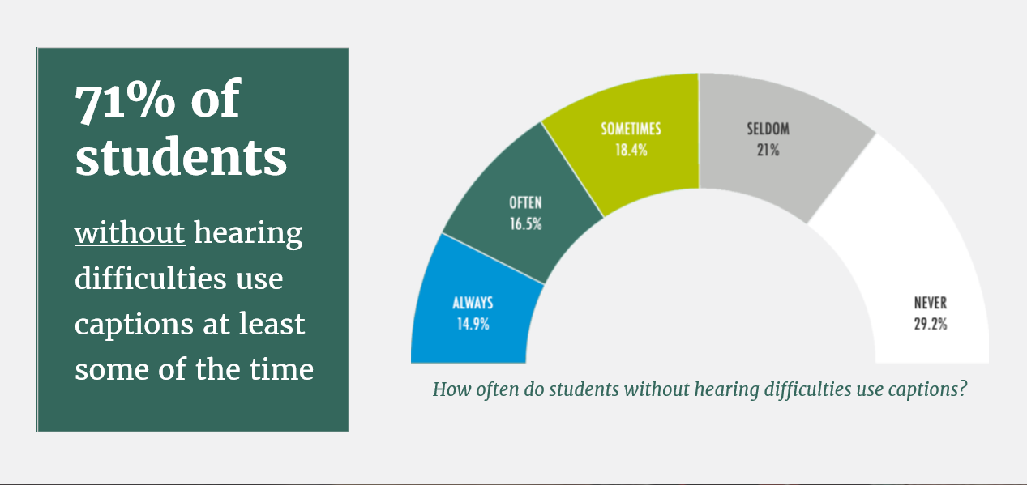
71% of students without hearing difficulties use captions at least some of the time
Notes:
Seventy one percent of student without hearing difficulties use captions at least some of the time

Slide 15
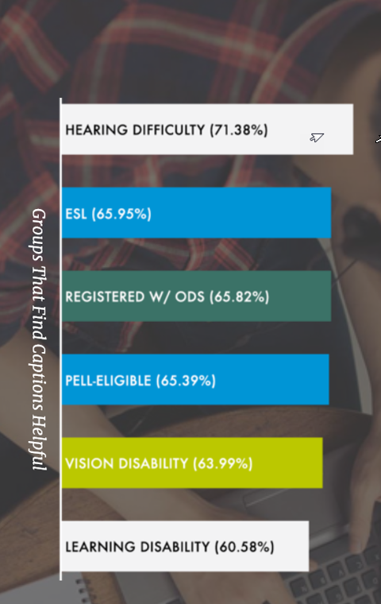
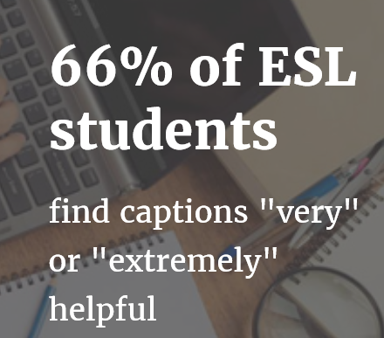
61% of ESL students find captions very or “extremely” helpful
Notes:
Sixty six percent of ESL students find captions very or extremely helpful

Slide 16
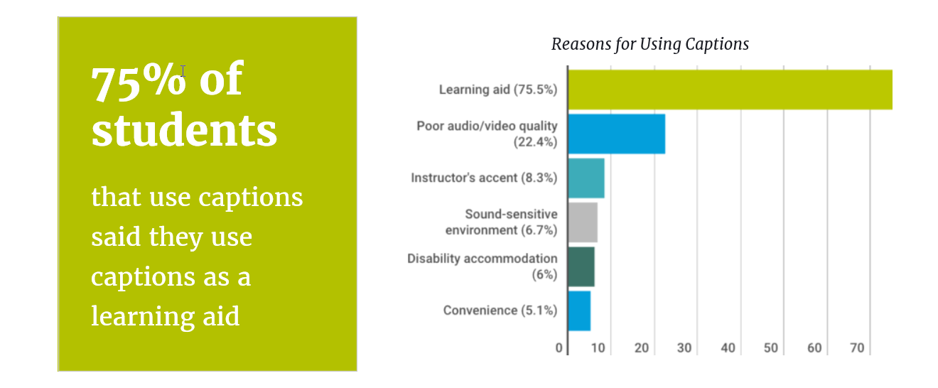
75% of students use captions as a learning aid
Notes:
Seventy five percent of students that use captions said they use captions as a learning aid

Slide 17
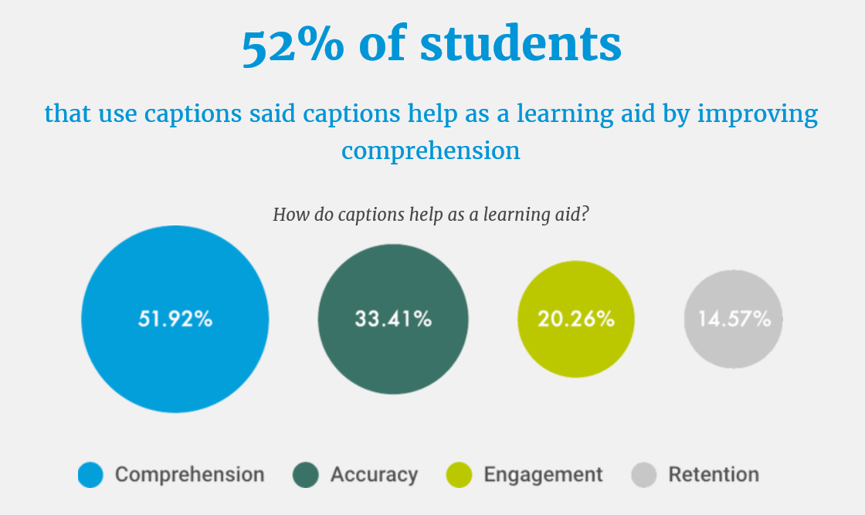
52% of students said captions help as a learning aid by improving comprehension
Notes:
Fifty two percent of students that use captions said captions help as a learning aid by improving comprehension

Slide 18
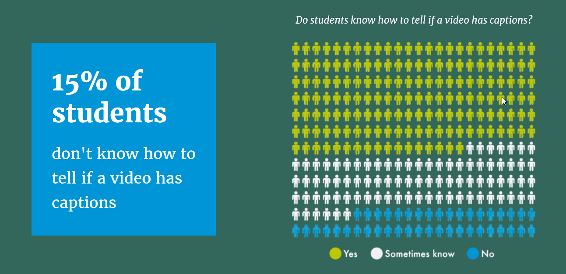
15% of students don’t know how to tell if a video has captions
Notes:
Fifteen percent of students don’t know how to tell if a video has captions

Slide 19
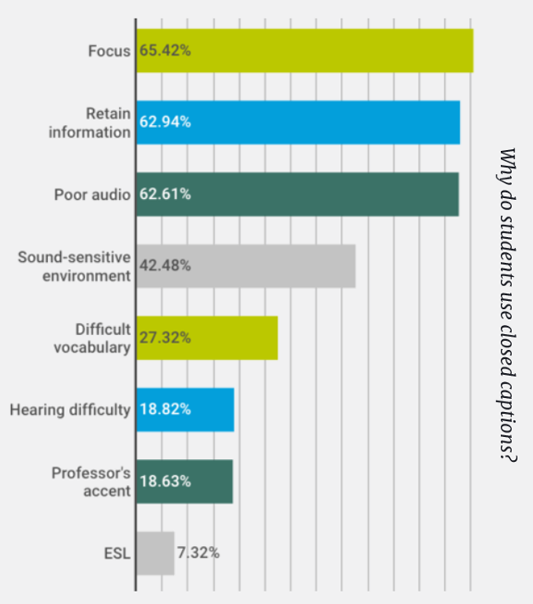
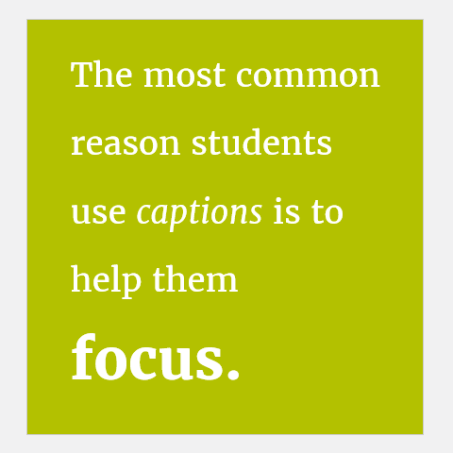
Common reasons students use captions
Notes:
The most common reason students use captions is to help them focus.

Slide 20
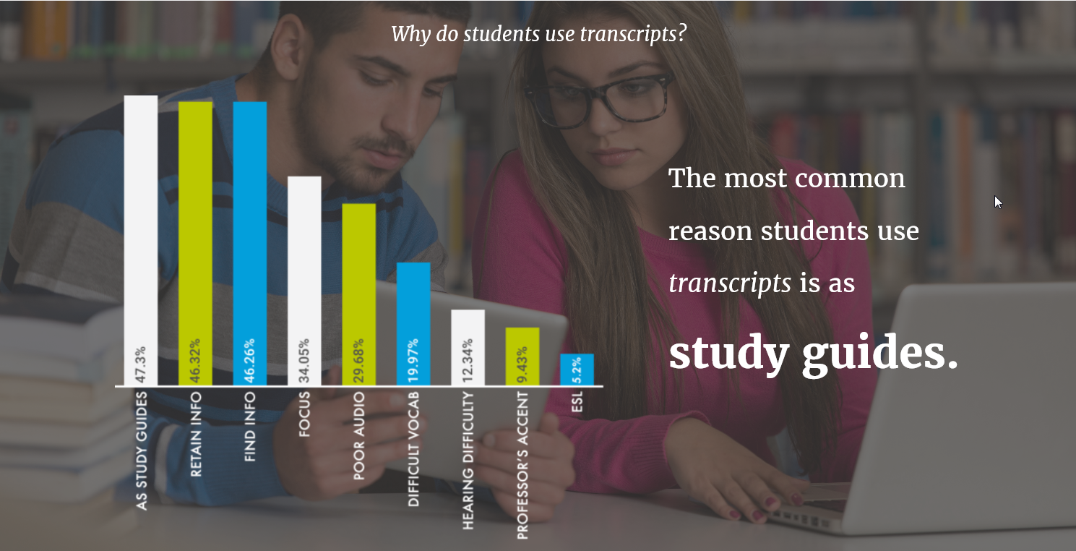
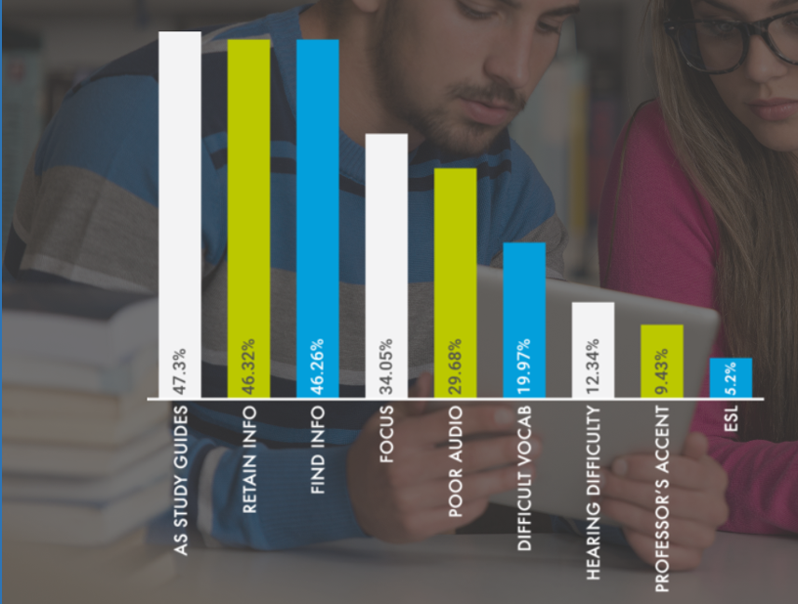
Reasons why students use transcripts
Notes:
The most common reason students use transcripts is as study guides

