Slide 1

Accessibility Techniques
Rhonda Bauerlein
Notes:
Hi! My name is Rhonda Bauerlein. This checklist will help you make online documents and other resources accessible for all students.

Slide 2
Resources
OEI Rubric:
http://bit.ly/oei-rubric
CC Faculty Canvas Resources Accessibility Module:
https://gcccd.instructure.com/courses/10582
Example Syllabi:
https://www.cuyamaca.edu/faculty-staff/example-syllabi.aspx

Slide 3
D1: Heading Styles
Heading styles are consistently used to aid navigation through the course when using assistive technology. Heading levels (Heading 1, Heading 2, etc.) are used in correct order. Fonts, colors, and formats (bold, italics, etc.) are not used in lieu of heading styles.
Notes:
Demonstration using Sample Syllabus for ENGL-120-020

Slide 4
Screen Reader User's Experience using Headings
https://youtu.be/D8XFkGMF0sw

Slide 5
D2: Lists
Lists are created using the bullet or numbered list tool instead of being formatted manually so that lists are recognized when using a screen reader.

Slide 6
D3: Links
Links are identified with meaningful and unique text in place of displaying the URL.
Notes:
Hyperlinks/hypertext provides clear information as to end location or function.
1. When creating hyperlinks, be descriptive as to the function or location the hyperlink will take the student.
2. Hyperlink text of "Click Here…" does not provide information as to "where" the hyperlink will take the student.

Slide 7
Screen Reader’s Experience with Links
https://youtu.be/D8XFkGMF0sw?t=174

Slide 8
Link Examples
  Student/Faculty mentor program is available for qualifying students. Click here for more information.
  Student/Faculty mentor program is available for qualifying students.
  Click here to submit a survey and a chance to win a $200 gift certificate.
  Submit a Survey for a chance to win a $200 gift certificate.
Notes:
This slide demonstrates how text can be rewritten to create more meaningful links than “Click here.”

Slide 9
D4: Tables
Column and/or row header cells are designated so that screen readers can read table cells in the correct order. A table caption is included for more complex tables.
Table makes sense when read from left to right, top to bottom
Notes:
Tables with data have appropriate row and column headers identified: It is necessary to identify the headers of the row and column data using "table header" methods or the scope attribute.
One of the best things you can do with a table is make sure it makes sense when read from left to right, top to bottom.

Slide 10
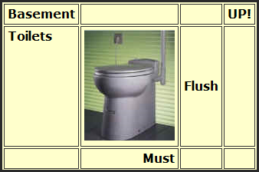
Table Example
Notes:
The screen reader will read this as:
Basement UP! Toilets Flush Must

Slide 11
Table Flow Example
 | Monday | Tuesday | Wednesday | Thursday | Friday
Start | 10 | 1 | 9 | 3 | 11
End | 11 | 3 | 10 | 4 | 12
Day | Start | End
Monday | 10 | 11
Tuesday | 1 | 3
Wednesday | 9 | 10
Thursday | 3 | 4
Friday | 11 | 12
Notes:
The purpose of data tables is to present information in a grid, and to have column headings or row headings that show the meaning of the information in the grid. Users of screen readers can navigate through data tables one cell at a time, and they will hear the column and row headers spoken to them if coded correctly and displayed with programs that have that ability.
This is another example showing that the most effective way to make tables accessible is to arrange the data so that it makes sense when reading the cells from left to right and top to bottom.

Slide 12
Best Practices for Tables
Keep tables simple
Avoid nested tables
Avoid splitting or merging cells
Keep heading labels short and descriptive

Slide 13
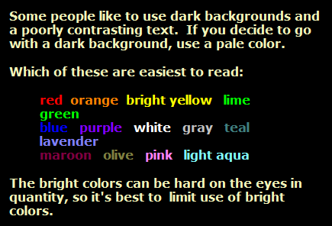
D5: Color Contrast
There is sufficient color contrast between the foreground text and background to avoid difficulties for students with low vision.
Notes:
1. Avoid using text and background colors that do not provide sufficient contrast.
2. Check the page to ensure hyperlinks and background colors have sufficient contrast.

Slide 14

D6: Color and Meaning
Color is not used as the only means of conveying information, adding emphasis, indicting action, or otherwise distinguishing a visual element.
Notes:
Other elements besides color are used to convey information.
When using color for Web-based materials, avoid using color by itself to convey information (e.g., click on the "green" hyperlinks).
2. Use of symbols may be used to identify a change in the presentation of content. For example, instead of using "red" to identify a change in content, use a "red asterisk".

Slide 15
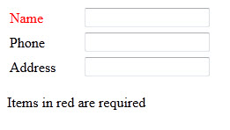
Inaccessible Example
Notes:
In this example, required fields are colored red.

Slide 16
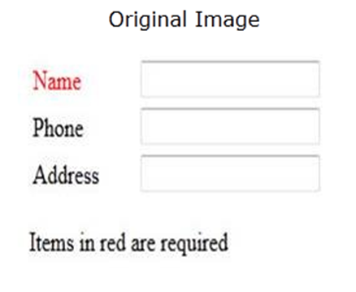
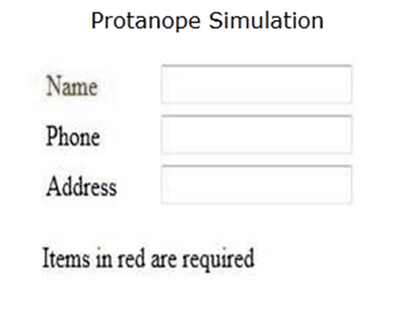
How it looks to someone who is color blind
Notes:
The example on the right shows how the form looks to someone who is color blind. There is no visible red on the right, so the color blind person cannot tell what field is required.

Slide 17
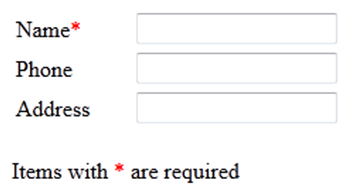
Accessible Example
Notes:
In this example, required fields are marked with an asterisk which is colored red. People who are color blind will be able to see the asterisk even though they can’t distinguish the its color. This works well for people with normal vision and for those who are color blind.

Slide 18
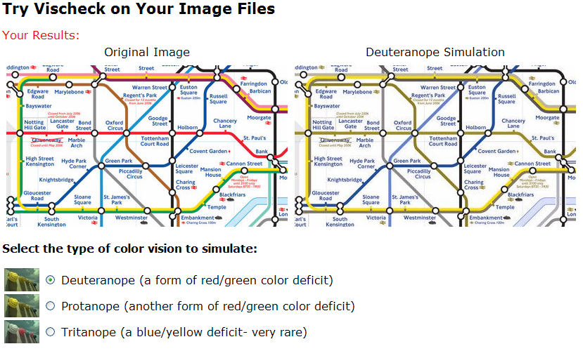
Map Example
Notes:
The reason we don’t want to use color alone to convey information is that people who are color blind or have limited eyesight may not be able to discern the information. Approximately seven percent of men and one percent of women are color blind which makes this the most frequently occurring disability. The image on this slide shows a map that has been rendered to show how it looks to someone with red/green color deficit. It would be impossible for you to tell a green route from a red route on this map if you were color blind. The Vischeck.com website can be used to make sure colors in your images will be viewable by everyone.

Slide 19
D7: Images
All images have appropriate alternative text, either explaining instructional value or indicating the image is decorative. Alternative text does not contain “image of”, “picture of” or file extension (e.g., “.jpg”).
Notes:
Images need to contain a text description using one of the following methods:
1. Include an alternate text description for the image.
2. For complex images, include a brief description within the text of the page.
3. If it is not possible to include a description of the image in the page, provide a link to a description of the image or use the "longdesc" attribute to link to an informational page.
Note:
Decorative images do not need an alternate text description. (alt="").

Slide 20
Screen Reader User's Experience with Images
https://youtu.be/D8XFkGMF0sw?t=115

Slide 21




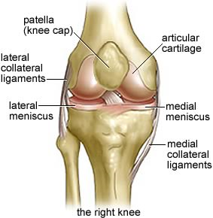
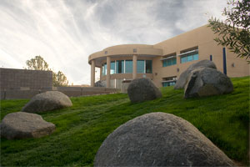
Image Examples
Notes:
Think of what alt text you might provide for these images.
The Cuyamaca College logo alt text should say “Cuyamaca College” or “Cuyamaca College Logo”. The important thing to remember is that if the image contains text, the text should be in the alt tag. An exception is when there is a LOT of text like the knee anatomy example.
The next image can have alt text that simply says “map.” If there is other information contained in the map that is relevant, you should explain that within the text of your document or website or Blackboard page.
The picture of the Science building in this case is purely decorative if it is just in the document to add some interest and color and not to convey some kind of information. It can have an empty alt tag.
The t-shirt alt tag should say something like “Cuyamaca College Coyotes t-shirt” to account for the text as well as what the image is of.
The next image is just a decorative element and doesn’t need an alt tag.
And finally, the picture of the knee can have an alt tag of “anatomy of the right knee.” If this was for an anatomy course, you would need to add some text to the document that describes the different parts of the knee to supplement this picture.

Slide 22
D8: Reading Order
Reading order is correctly set so that content is presented in the proper sequence when using screen readers and other assistive technologies.
Notes:
Demonstrate with PowerPoint

Slide 23
D9: Slides
Slides are created using built-in accessible slide layouts with each slide having a unique title. All text is visible in Outline View to be sure that it can be read by assistive technology.
Notes:
Demonstrate with PowerPoint

Slide 24
D10: Spreadsheets
Spreadsheets include labels for the rows and columns, detailed labels for charts, and are accompanied by textual descriptions that draw attention to key cells, trends, and totals.
Microsoft Excel Accessibility Instructions

Slide 25
D11: Accessibility Checkers
Files and content pages pass any built-in accessibility check available in the software.
Microsoft Office:
File > Info > Check for Issues > Check Accessibility
Adobe PDF
Tools > Accessibility > Full Check

Slide 26
D12: Video
All video must have accurate captions. If a video has no audio or instructionally relevant soundtrack, a note explaining that should accompany the video.
Captioning is available free via 3cmediasolutions.org

Slide 27
D13: Audio
Audio files must be accompanied by complete and accurate transcripts.
Notes:
Audio content requires a text transcript of the corresponding audio information.
1. For spoken audio such as podcast, provide a link to a text transcription of the audio content.
2. If the audio track is music, identify the musical composer and any lyrics as part of the track.

Slide 28
D14: Flashing Content
Blinking or flashing content, including gifs, should only be used if instructionally needed and not merely for decoration or emphasis. Flashing content must not flash more than three times in any one second period or exceed the general and red flash thresholds.

Slide 29
D15: Live Captions
Live broadcast and synchronous video conferences must include a means for displaying synchronized captions if requested.
How to request live captioning for Zoom.

Slide 30
D16: Auto-play
Audio and video content should not be set to auto-play. If any audio on a web page does auto-play for more than three seconds, a mechanism must be available to pause, stop, and control the volume.
Notes:
Make sure the playback controls can be accessed from the keyboard (e.g., "tab key").
If not, allow the user to open the media player on their computer (as opposed to embedding the player on a Web Page).

Slide 31
Only use underline for links
Do not use underline for anything except links to files or pages. Use bold, italics, or color to emphasize text instead of underline.
Book titles should be italicized.

Slide 32
Accessibility Workshop Resources
Handouts and material for this workshop can be found at:
http://www.cuyamaca.edu/people/rhonda-bauerlein/workshops/accessibility-workshop.aspx

